Slide 1


SmartTracker-COVID-19
Presenting solution for COVID-19
Name : Pramod Paratabadi
pramodp151999@gmail.com
9158038227
Name : Supriya Madiwal
supriyasmadiwal@gmail.com
8208213703

Slide 2
Table of Content
Introduction
Problem Statement
Implementation - A brief Idea
Tech Stack Used
Screenshots
Conclusion

Slide 3
Introduction
Coronavirus - The Invisible Killer
Currently , the world is grappling with an invisible, deadly enemy, trying to understand how to live with the threat posed by a virus. It has stretched around the world, it’s sparked a crop of diary entries and essays that describe how life has changed.
This is a pandemic, a global crisis and tragedy on a scale that’s hard to fathom.
There are a lot of new things for the public to learn — about the virus, controlling its spread, social distancing, treating the sick, and how our governments should react to this chaotic situation. It’s like we’ve all been dropped in to study for a test in a class that no one signed up for. It’s confusing and hard to process.

Slide 4
Problem Statement
Coronavirus (COVID-19) - the biggest pandemic of 21st century has hit people all over the world pretty badly. All sorts of activities have been hampered by this pandemic.
Now a days whole world facing the novel Corona Virus, to track the spread of novel Corona Virus country-wise, details of confirmed cases, deaths and Recovered, awareness regarding COVID-19.

Slide 5
Implementation
The Android app named as ‘SmartTracker-Covid-19’ created to spread
awareness about the COVID -19 virus. App includes following functionalities:
CoronaEx Section : It is a explorer section includes latest new updates, Real-time Dashboard that tracks the recent cases of covid-19 across the world and across different states in India with relevant death and recovered cases and Prevention to take.
CoronaQuiz section : quiz that will help people know about the Corona virus and its effects on human body.
Helpline Section : As this application particularly made for Indian citizen to use, All state helpline number of India included.
Chatbot Section : A self-assisted bot made for the people navigate corona virus situation.
Common Questions: Start screening , What is COVID-19? , What are the symptoms?

Slide 6



Tech Stack Used
We will be going to make use of the following tools and technologies to build our application -
Android Studio
SQLite3DB
Dialogflow

Slide 7
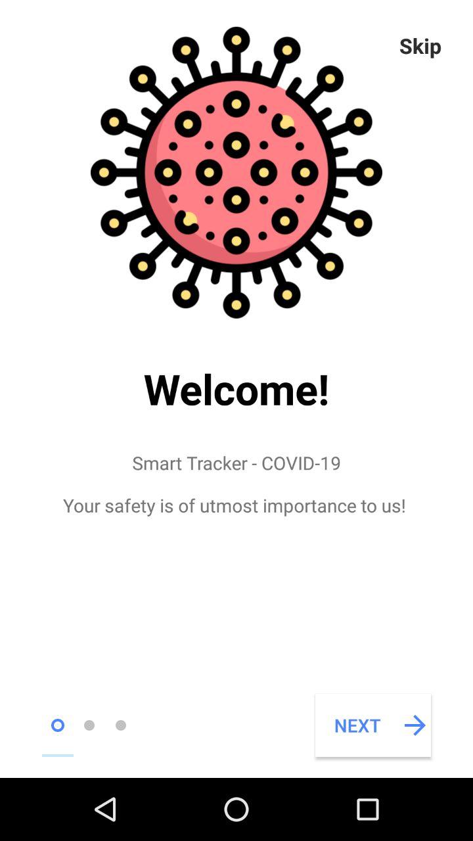
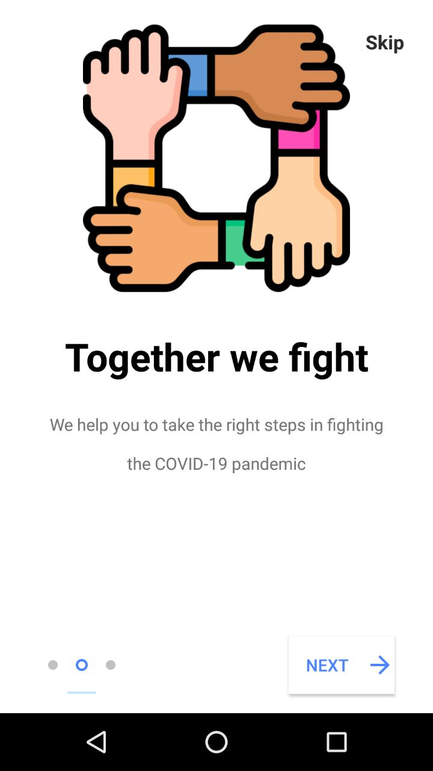
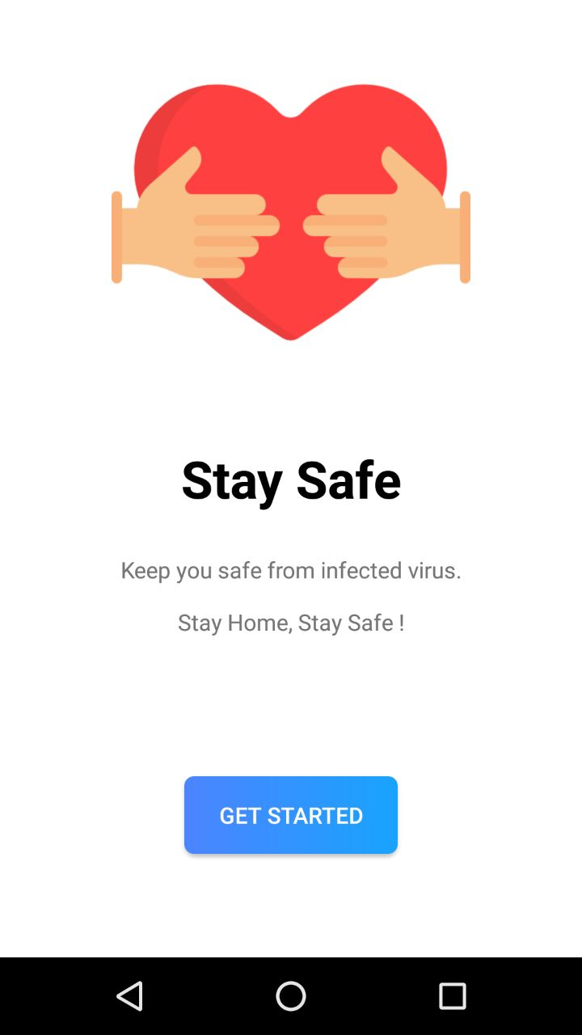
SmartTracker-COVID-19
Getting Started

Slide 8
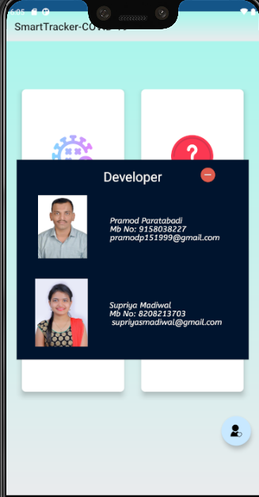
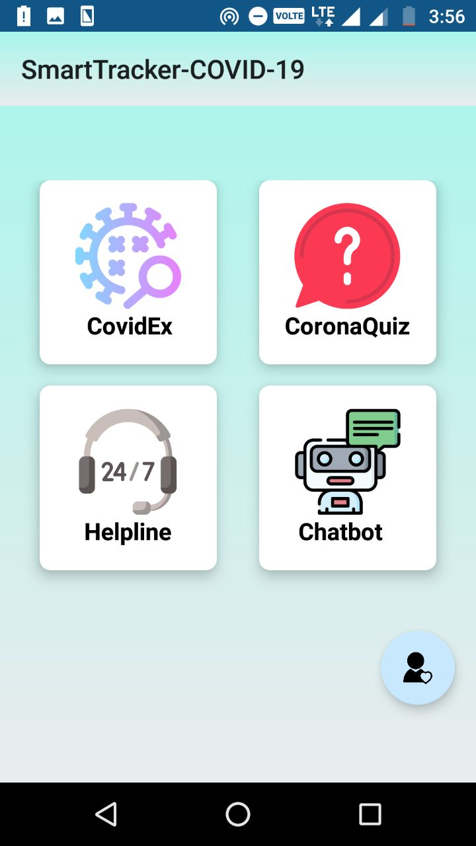
SmartTracker-COVID-19
Main Tab
Developer

Slide 9
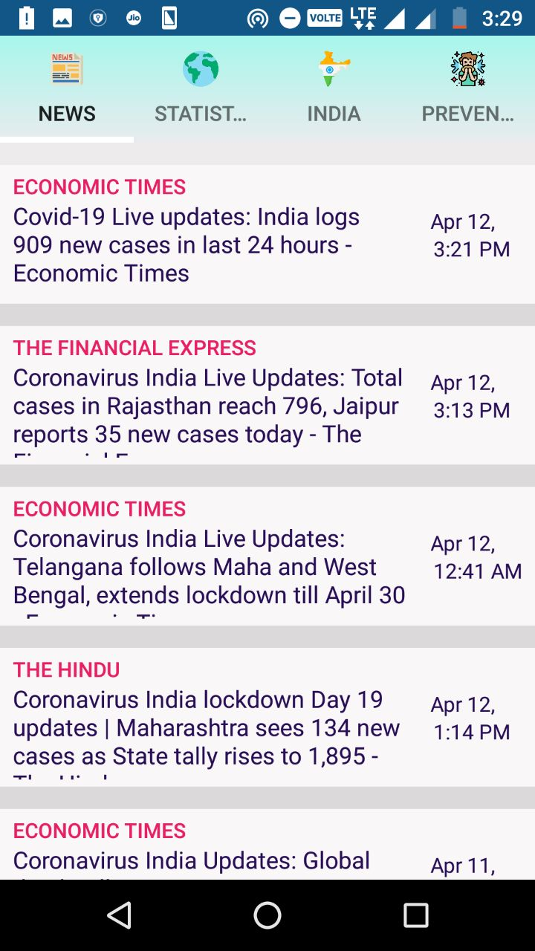
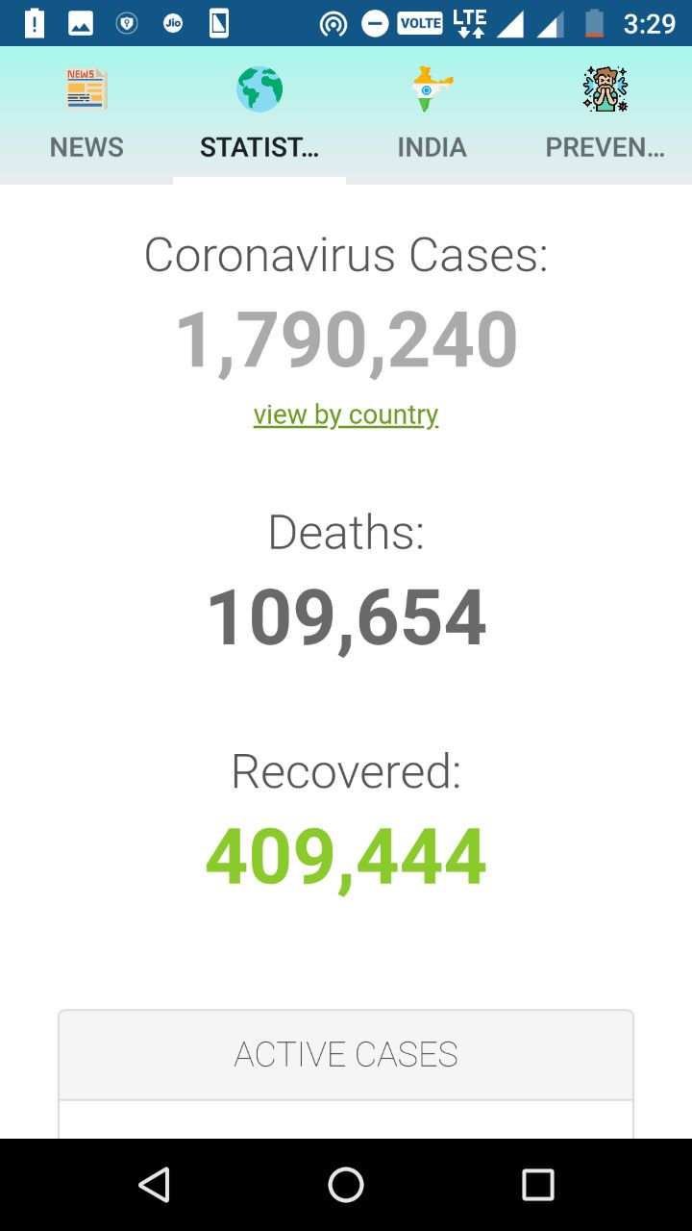
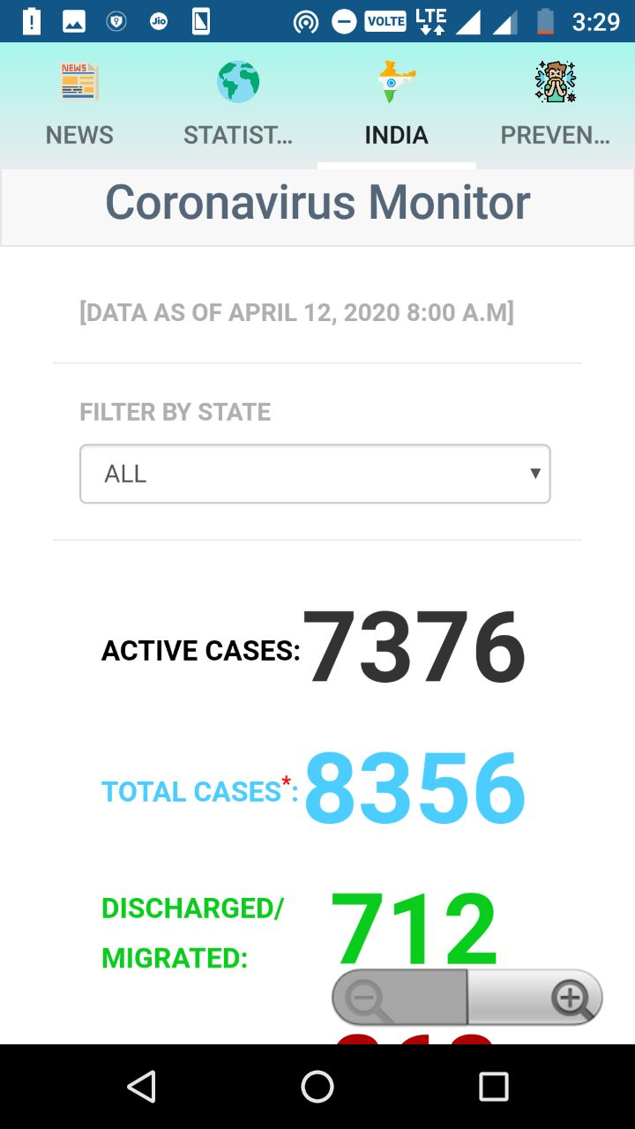
SmartTracker-COVID-19
CovidEx
News Feed
World Statistic
India Statistic

Slide 10
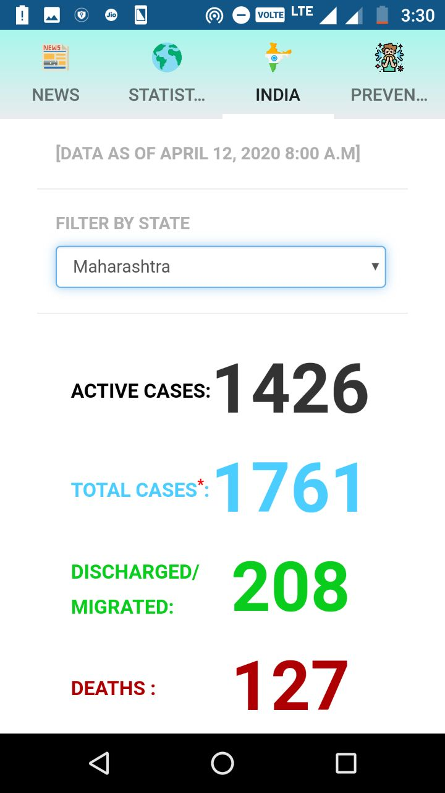
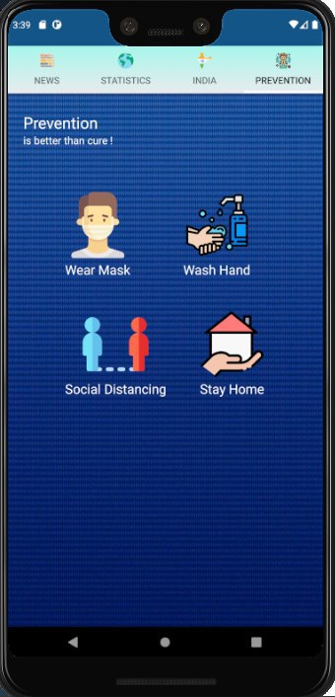
SmartTracker-COVID-19
Continue…
CovidEx
State-wise Statistic
Prevention

Slide 11
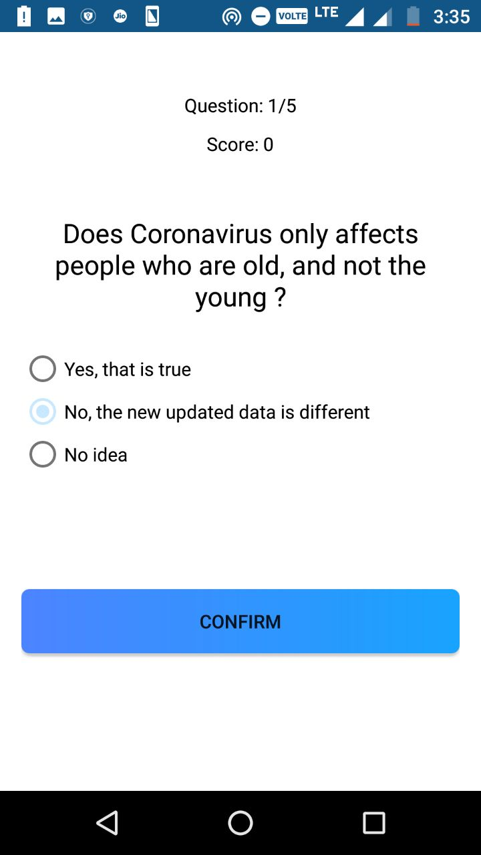
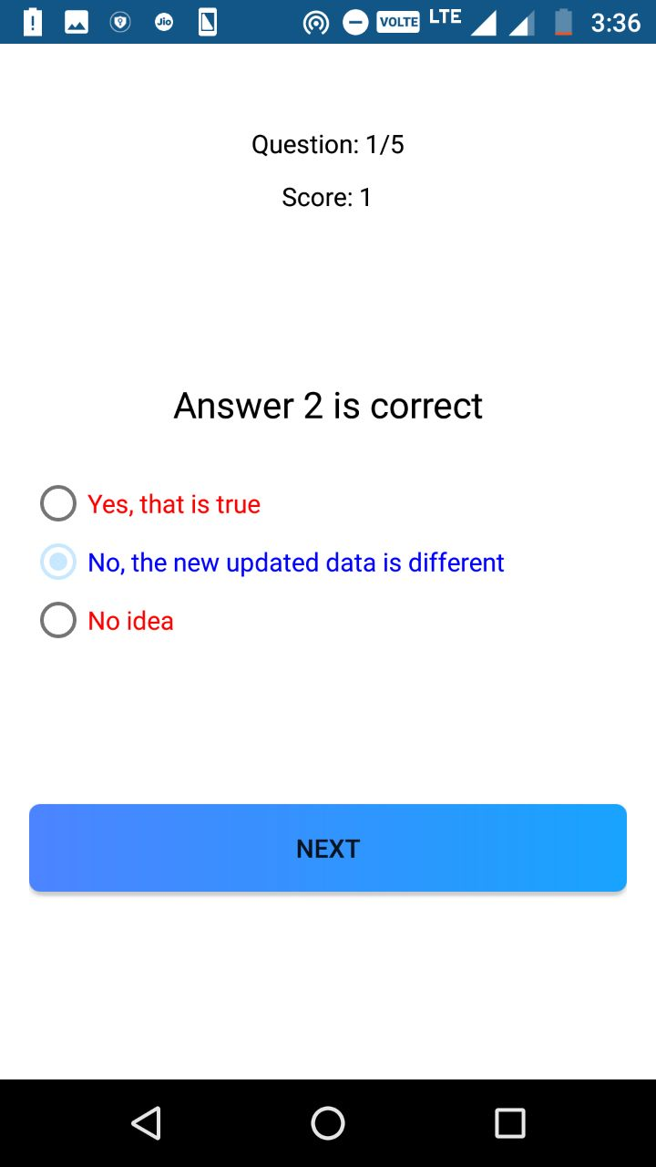
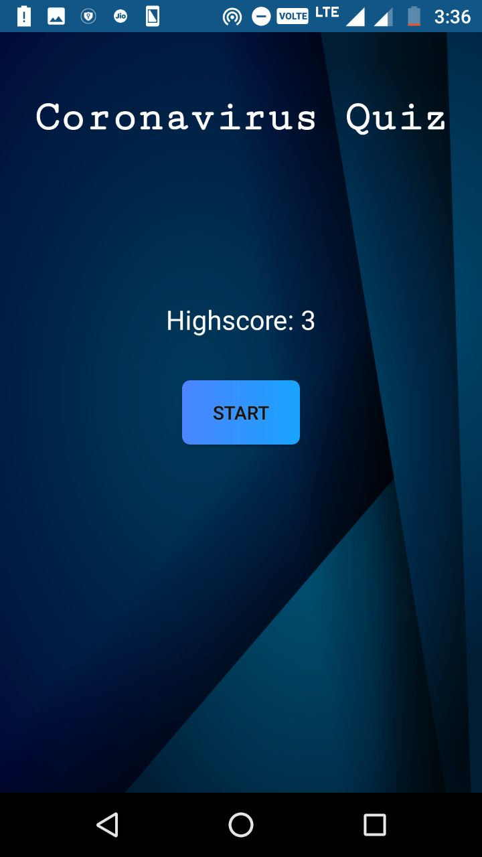
SmartTracker-COVID-19
CoronaQuiz

Slide 12
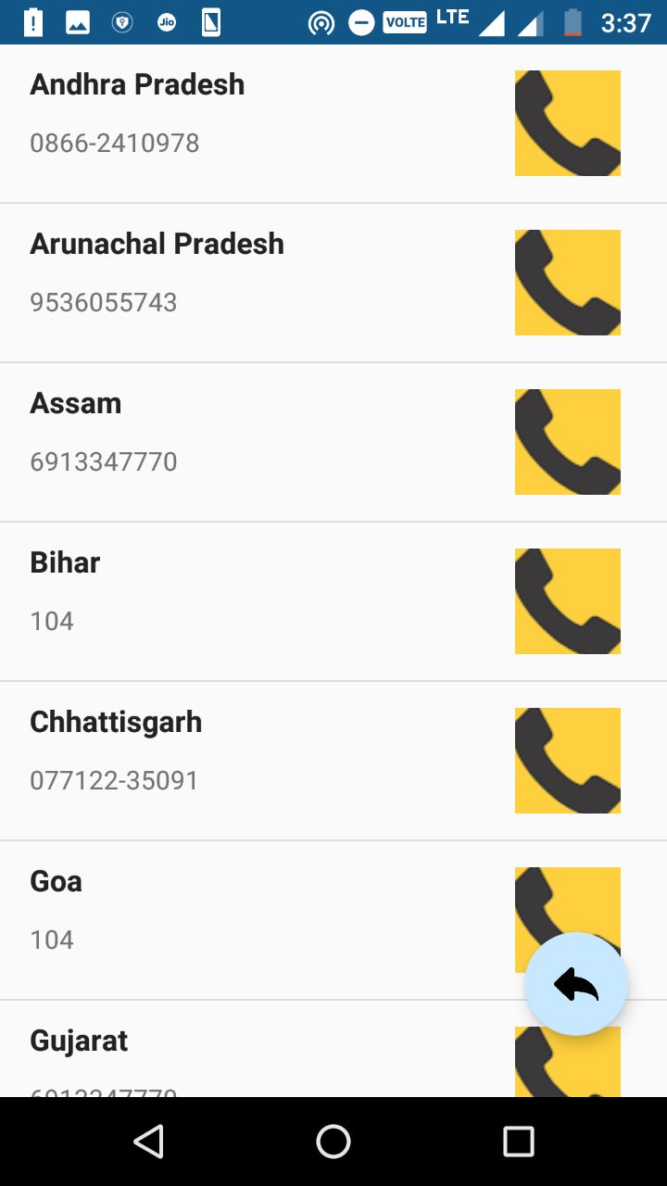
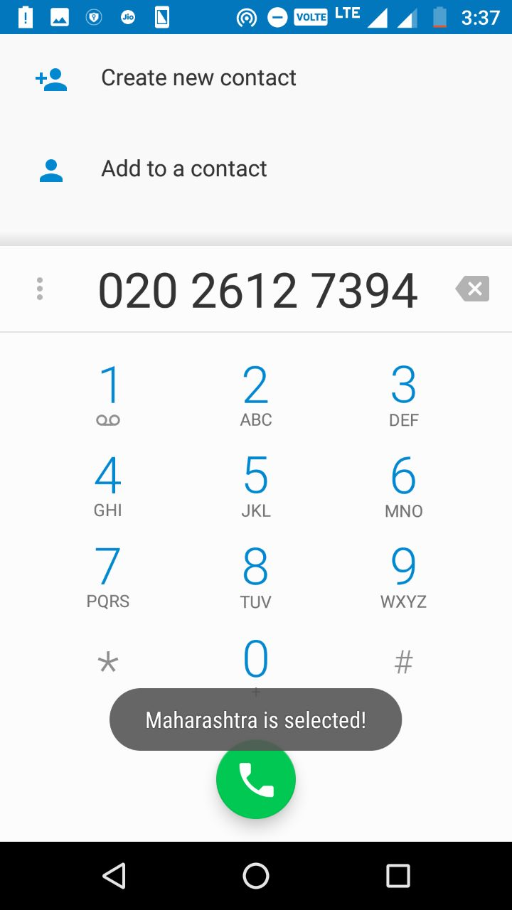
SmartTracker-COVID-19
Helpline

Slide 13
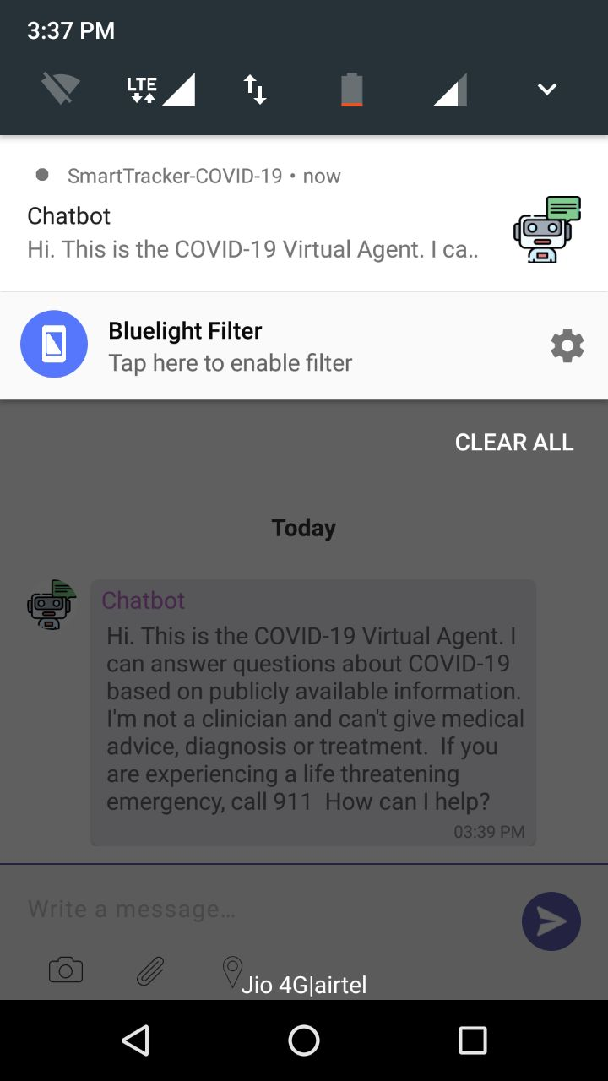
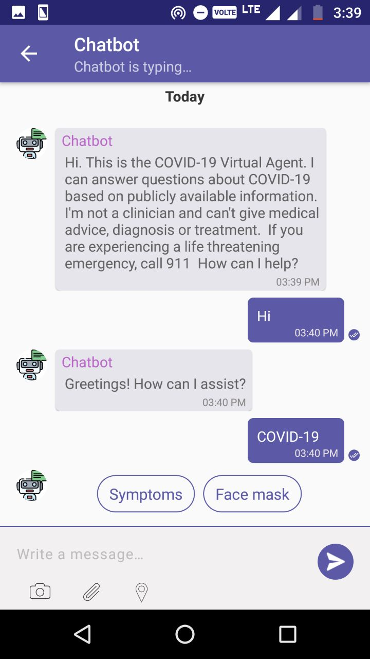
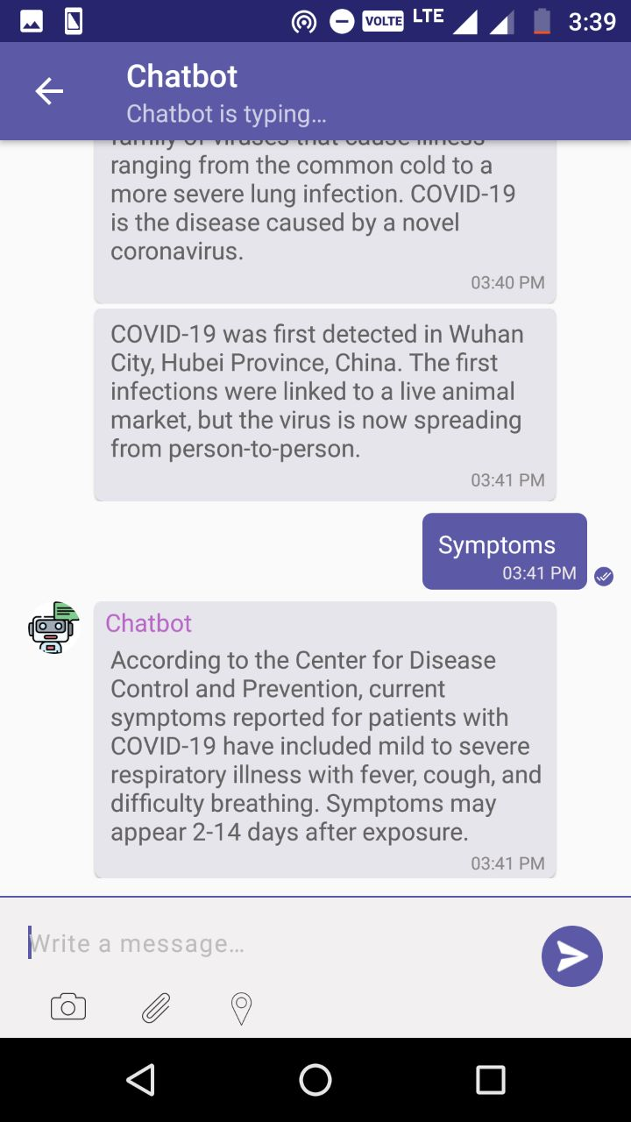
SmartTracker-COVID-19
Chatbot

Slide 14
Conclusion
COVID-19 is a serious issue to the Global Health sector as well as in economy. It is very vital to make awareness among people to reduce the spread of this pandemic. On behalf of the above scenario our ‘SmartTracker- COVID-19 ‘ will help the people to get insights of the pandemic and strategies to remain safe.

